Slide 1

Movie Recommendation System
Presentation Prepared by,
Aleena Paulose, Anusha Siby, Mary Tannia Padua,, Sanju Parathattel Saji, Swedha Sankara Pillai

Slide 2

Introduction
We made a website called Movie Flick, designed to provide personalized movie recommendations and analyze user sentiments, enhancing the movie discovery experience.
Our system recommends movies based on the content of the user's favorite movie. We ensure the recommendations align closely with the user's preferences by analyzing attributes such as genre, cast, and plot.
Users can make informed decisions based on sentiment analysis, ensuring they choose movies that resonate positively with viewers.

Slide 3
Key Feature
Advanced Recommendation Algorithm:
The app utilizes a sophisticated recommendation algorithm that analyzes user input and movie data to suggest relevant and engaging movie options.
Interactive User Interface:
The app offers an intuitive and interactive user interface, making it easy for users to input their favorite movie title and explore personalized recommendations.
Real-time Movie Data Integration:
Integrated with the powerful TMDB API, the app retrieves real-time movie data, including details, posters, ratings, and reviews, to provide a comprehensive movie exploration experience.
Seamless Integration with Flask:
Built using Flask, a Python web framework, the app seamlessly connects the front-end user interface with the back-end recommendation engine.

Slide 4
User Experience
Easy Title Entry: Users can simply enter a movie title they enjoyed or were intrigued by, allowing the app to analyze their preferences.
Detailed Movie Insights: The app provides users with comprehensive information about recommended movies, including posters, overviews, ratings, genres, release dates, and more.

Slide 5

Technologies Used
Python:
The core programming language is used for developing the movie recommender system's backend and handling data processing, analysis, and model training.
Flask:
A lightweight web framework in Python was used to build the web application, handle routes, and manage data flow between the front and backend.
HTML/CSS:
Web technologies are used for designing and styling the web application's user interface, providing an attractive and intuitive user experience.

Slide 6
JavaScript (jQuery):
JavaScript enhances interactivity on the frontend, enabling dynamic elements like autocomplete, button actions, and AJAX requests.
AJAX (Asynchronous JavaScript and XML):
AJAX makes asynchronous requests to the server, enabling real-time interactions without requiring a full page reload.
Pandas:
A data manipulation library in Python used for data preprocessing, transformation, and analysis, particularly for managing movie data.
Scikit-learn:
A machine learning library in Python used for building and training the content-based recommender system, calculating cosine similarities, and more.
Natural Language Processing (NLP):
Techniques from NLP are applied to analyze movie reviews and perform sentiment analysis to understand the sentiments expressed by users.

Slide 7
The Movie Database (TMDB) API:
An external API used to fetch real-time movie details, including movie posters, cast information, release dates, and more.
Pickling:
Pickling is used to serialize and store trained machine learning models (NLP model, TF-IDF vectorizer) to disk for quick access and reuse.
Web Scraping (Beautiful Soup):
Beautiful Soup is used to scrape data from websites, extracting movie details and reviews for analysis.
JSON:
JSON (JavaScript Object Notation) is used for data exchange between the front end and backend and API responses.
Deployment Platform:
The application deployed on AWS to make it accessible to users.

Slide 8

Quick Look Into Front-End
About Us page – Brief Description about us
Home Page – Searching for movie with Auto-Completion of title function
Recommend Page – Showing Details of the Movie, Sentiment Analysis of Reviews, and Recommended movies related to the searched movie.
Index Page – Welcoming Users into our web application
We have four pages for this web application
The front end of our movie recommendation web app is the user's gateway to the system.

Slide 9

Front End Functions
Implement an auto-complete feature for movie title input for that we using autocomplete.js
Enhances user experience by suggesting relevant movie titles.
TMDB API: A powerful resource for accessing movie data, including posters, overviews, ratings, and more.
jQuery used to handle input changes and display suggestions.
Recommend.js is used for showing details and fetching details from TMDB API and Performing AJAX
AJAX requests to fetch and display data without page reload.
Dynamically populate movie posters, overviews, genres, ratings, and other information.
Seamless connection between front-end and TMDB API empowers users to explore movies confidently.

Slide 10
Flask Implementation
The `main.py` file is the heart of this web application that handles the backend logic, routing, and communication with various parts of movie recommendation web. It's responsible for coordinating data processing, handling user requests, and rendering templates for the frontend.
Define different routes using the `@app.route` decorator. Each route corresponds to a different page or functionality of your web app.
For example, the `/home` route renders the home page, `/similarity` route handles similarity searches, and `/recommend` route handles movie recommendations.
Inside each route's view function, render the appropriate HTML templates using `render_template` from Flask. Pass and receive any necessary data to the templates.
Use AJAX to send asynchronous requests to external APIs like TMDB to fetch movie details or reviews.
Handle the API responses and extract relevant data.

Slide 11
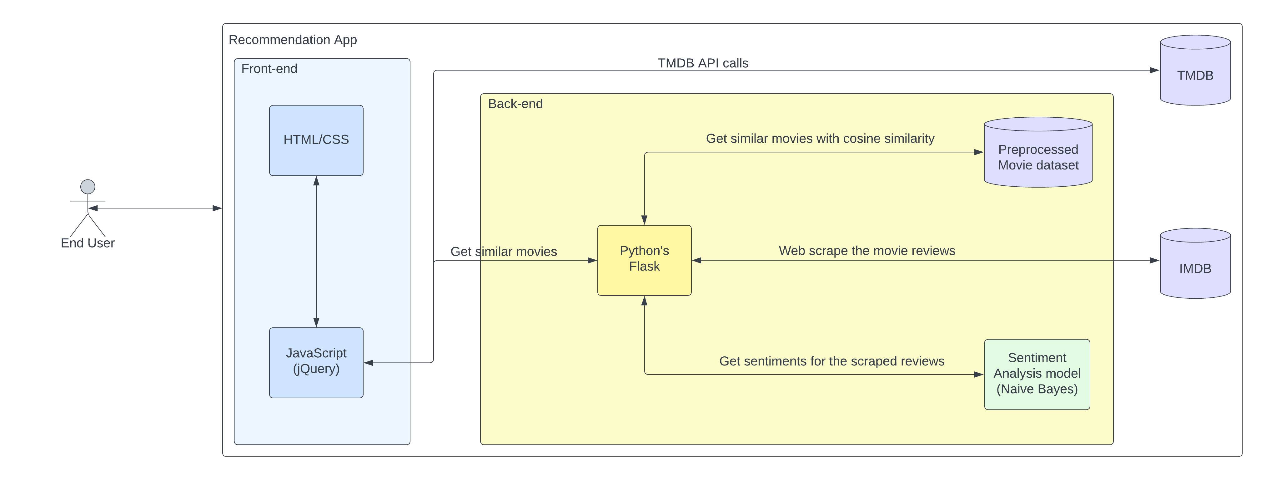
Architecture

Slide 12

Pre-processed Movie Dataset
Datasets Used:
movies_metadata.csv: The main Movies Metadata file. Contains information on 45,000 movies featured in the Full MovieLens dataset. Features include posters, backdrops, budget, revenue, release dates, languages, production countries and companies.
credits.csv: Consists of Cast and Crew Information for all our movies. Available in the form of a stringified JSON Object.
Wikipedia: Used Wikipedia to get list of movies in 2018, 2019 and 2020

Slide 13

Similarity Score
In this project, the "Similarity Score" refers to a quantitative measure of how alike two movies are regarding their content and characteristics. The similarity score is calculated using the concept of cosine similarity, a mathematical measure that evaluates the cosine of the angle between two vectors. In the context of a content-based movie recommender system, the vectors represent the features or attributes of the movies.
Here's how the similarity score is computed in the project:
1. Feature Extraction:
- Relevant movie features are extracted, including movie genres, cast, crew, and other textual information.
2. Vector Representation:
- Each movie is represented as a vector in a high-dimensional space, where each dimension corresponds to a specific feature.

Slide 14

3. Cosine Similarity Calculation:
- The cosine similarity between two movie vectors is calculated using the formula:
similarity = (A . B) / (||A|| * ||B||)
where `A` and `B` are the vectors representing two different movies.
4. Recommendation Process:
- When a user provides the title of a movie they like, the system calculates the similarity score between this movie and all other movies in the database.
5. Top Similar Movies:
- Movies with the highest cosine similarity scores to the user's selected movie are considered most similar. The system then recommends the top N movies based on these scores.
6. Personalization:
- The similarity score contributes to personalized recommendations. If a user likes a specific movie, the system suggests other movies that have similar content, catering to the user's preferences.

Slide 15
Scrapping Reviews
To web scrape movie reviews from IMDb using BeautifulSoup (bs4) in this project, we followed these steps:
1. Send HTTP Request: Use the `requests` library to send an HTTP GET request to the IMDb movie page URL.
2. Parse HTML: Parse the HTML content of the page using BeautifulSoup to extract the relevant information.
3. Locate Reviews: Used BeautifulSoup to locate the page section containing user reviews.
4. Extract Reviews: Extract the text of individual reviews from the HTML elements.
5. Store Reviews: Stored the extracted and cleaned reviews in a suitable data structure.
6. Sentiment Analysis: To analyze the sentiments of the reviews, used natural language processing (NLP) libraries NLTK.

Slide 16

Sentiment Analysis Model
Our Movie Recommendation Web App enhances user experience by including sentiment analysis using the Naive Bayes algorithm.
Why Naive Bayes?
- Efficient and easy to implement.
- Well-suited for text classification tasks.
- Performs well with limited training data.

Slide 17
How It Works!?
The Naive Bayes algorithm calculates the probabilities of a review belonging to good or bad sentiment classes based on the words in the review.
When scraping a review from the IMDb, pass the review text through your Naive Bayes model to predict the sentiment.
Displaying the sentiment prediction (e.g., “Good" or “Bad") along with the user's review on the web app's interface.
Evaluate the performance of your sentiment analysis model using the testing set. Calculate accuracy to assess its effectiveness.

Slide 18

Conclusion
The Movie Recommendation Web App revolutionizes how users discover new movies, offering an intelligent and enjoyable way to explore and engage with a world of cinematic choices. Whether you're a film enthusiast or looking for your next movie night selection, our website is your trusted movie companion. Experience the future of movie recommendations today!
Movie Flick

Slide 19
REFERENCES
Prabhakaran, S. (2022, April 20). Cosine similarity - understanding the math and how it works? (with python). Machine Learning Plus. https://www.machinelearningplus.com/nlp/cosine-similarity/
Banik, R. (2017, November 10). The movies dataset. Kaggle. https://www.kaggle.com/datasets/rounakbanik/the-movies-dataset

Slide 20

Thank You

